Slide 1
National Scholarship Portal
Team Members :
Nikhil Mundey
Ishita Deshmukh
Gunjan Kotak
Seema Mane

Slide 2
Abstract
National Scholarship portal is a project developed with the main aim of providing an easy and efficient way for applying and getting a scholarship for students in need of it.
Students will access the web portal by login to the portal and can apply for the scholarship schemes.
Government has offered various scholarships based on various criteria like merit, minority and specially for girls to encourage them for Education.

Slide 3
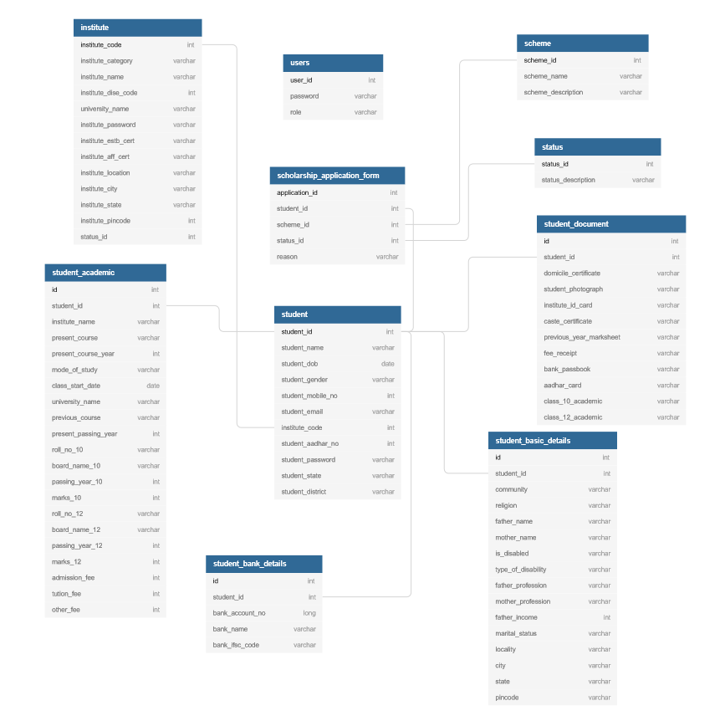
Schema

Slide 4
Assumptions and scope of project

Slide 5
Technologies and tools version
Eclipse
Tomcat
Java
HTML
JSP
Spring MVC
JPA
Oracle SQL Developer

Slide 6
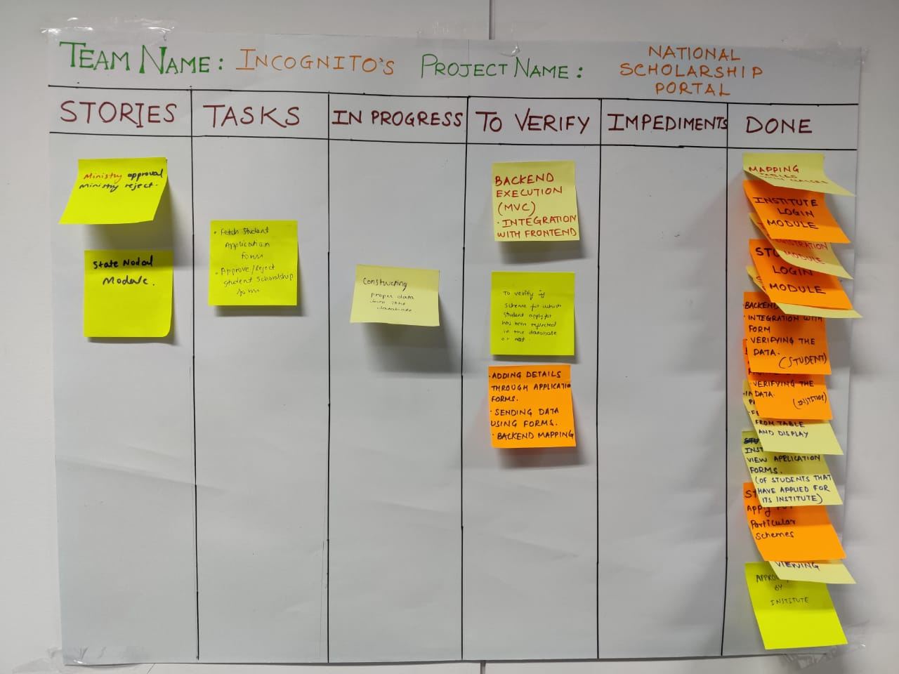
SCRUM BOARD SNAPSHOT

Slide 7
THANK YOU

